Slide 1

Online Car Insurance Payment
and Renewal System

Slide 2
Our Client
Insurance Corporation of British Columbia (ICBC)
Provincial crown corporation
Only designated company to provide the mandatory car insurance services in BC
Notes:
The Insurance Corporation of British Columbia (ICBC) is a provincial crown corporation and
the only designated company to provide the mandatory car insurance services in BC.
By provincial law, any vehicle registered, driven or parked on public spaces in BC
must be covered by ICBC insurance package (Autoplan) through independent brokers.

Slide 3

Statement of Purpose
In the age of computers, ICBC still doing business in old ways
Brokers retain customers because of convenience
The technologies already exists
Already have their customer to renew insurance and receive decals online: Ontario, US
Notes:
Today, in the age of computers, ICBC still does business like it did 45 years ago: through brokers or having car owners go to brokerages in person annually. Other provinces and countries such as Ontario and the United States allow customers to renew their car insurance and receive their decals online, so we know the technology exists. Our team will develop a website where British Columbians can renew their ICBC car insurance. The focus will be on providing customers with a convenient method of doing renewals without removing the need for brokers.

Slide 4

Current System Backgrounds
System: Old, inconvenient, and inefficient
Customers: Need to know a broker or walk into a brokerage everytime they need something.
Simple procedures are time consuming and sometimes expensive

Slide 5
Main Objectives
Develop web based system for British Columbians to
Change basic personal information
Renew car insurance
Change vehicle rate class & coverage
Receive decals
Ensure the system follows BC’s privacy laws
Provide brokers with another sales tool
Referral system
Focus on the convenience and effectiveness
Client Retention

Slide 6
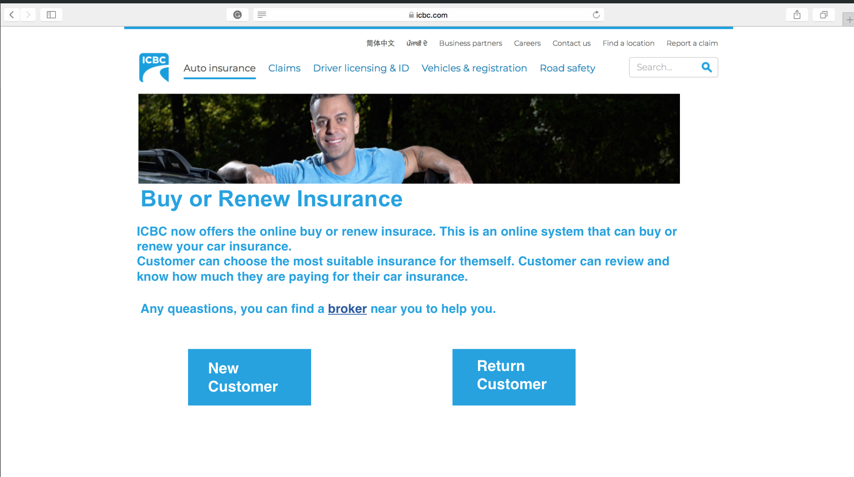
Proposed Web-based System
Home Page

Slide 7
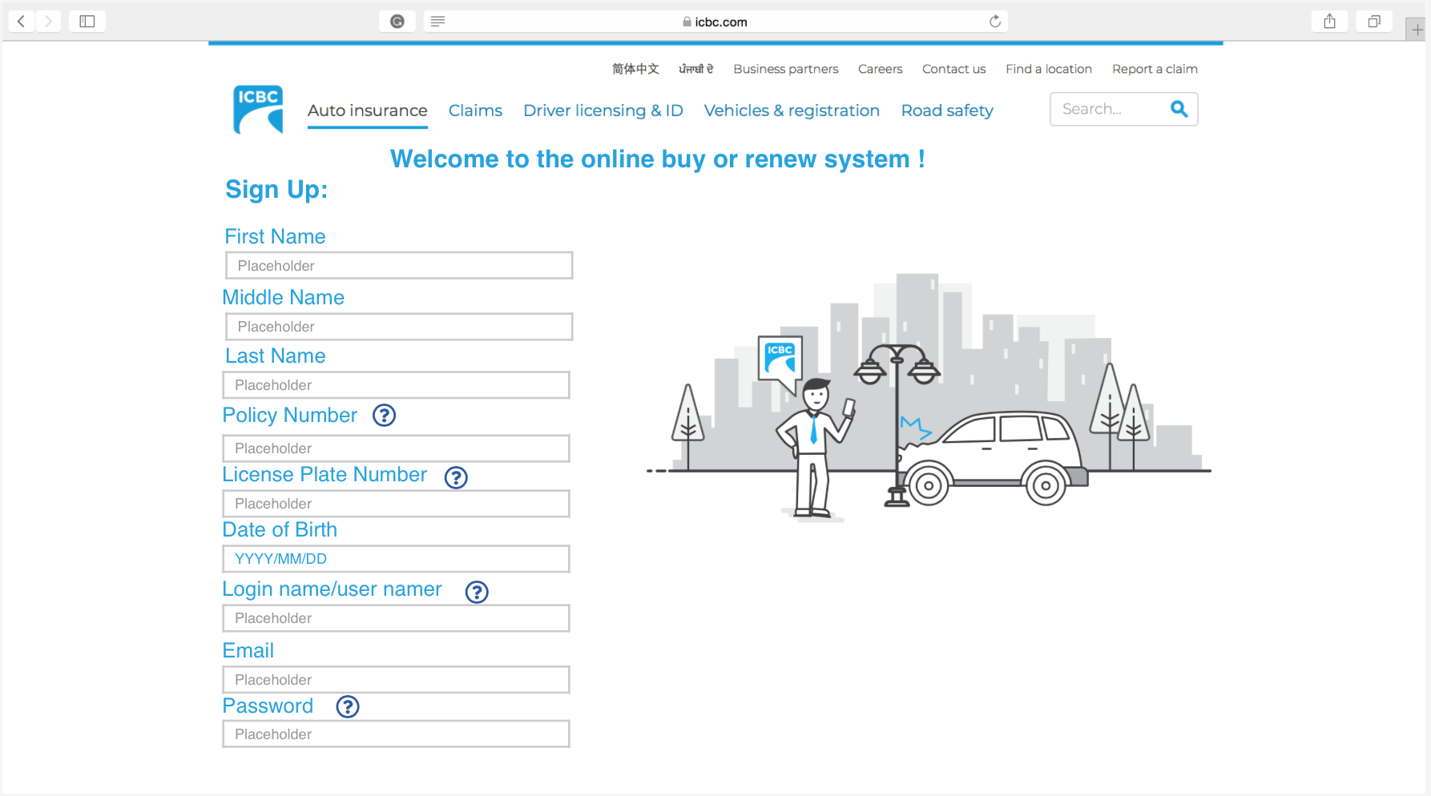
New Customer Sign-up Page

Slide 8
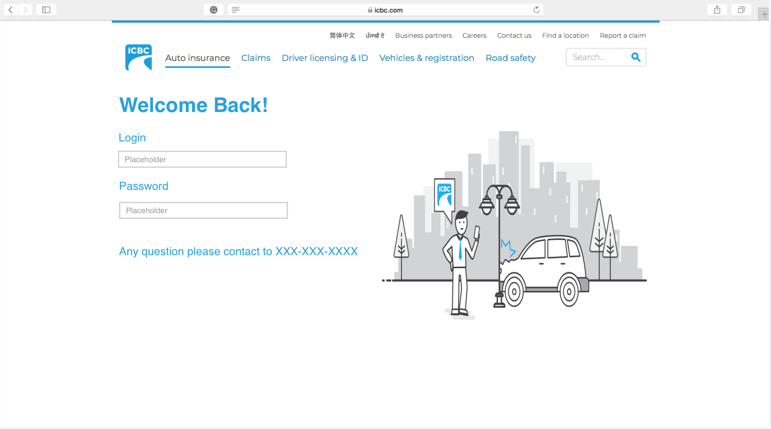
Return Customer Login Page

Slide 9
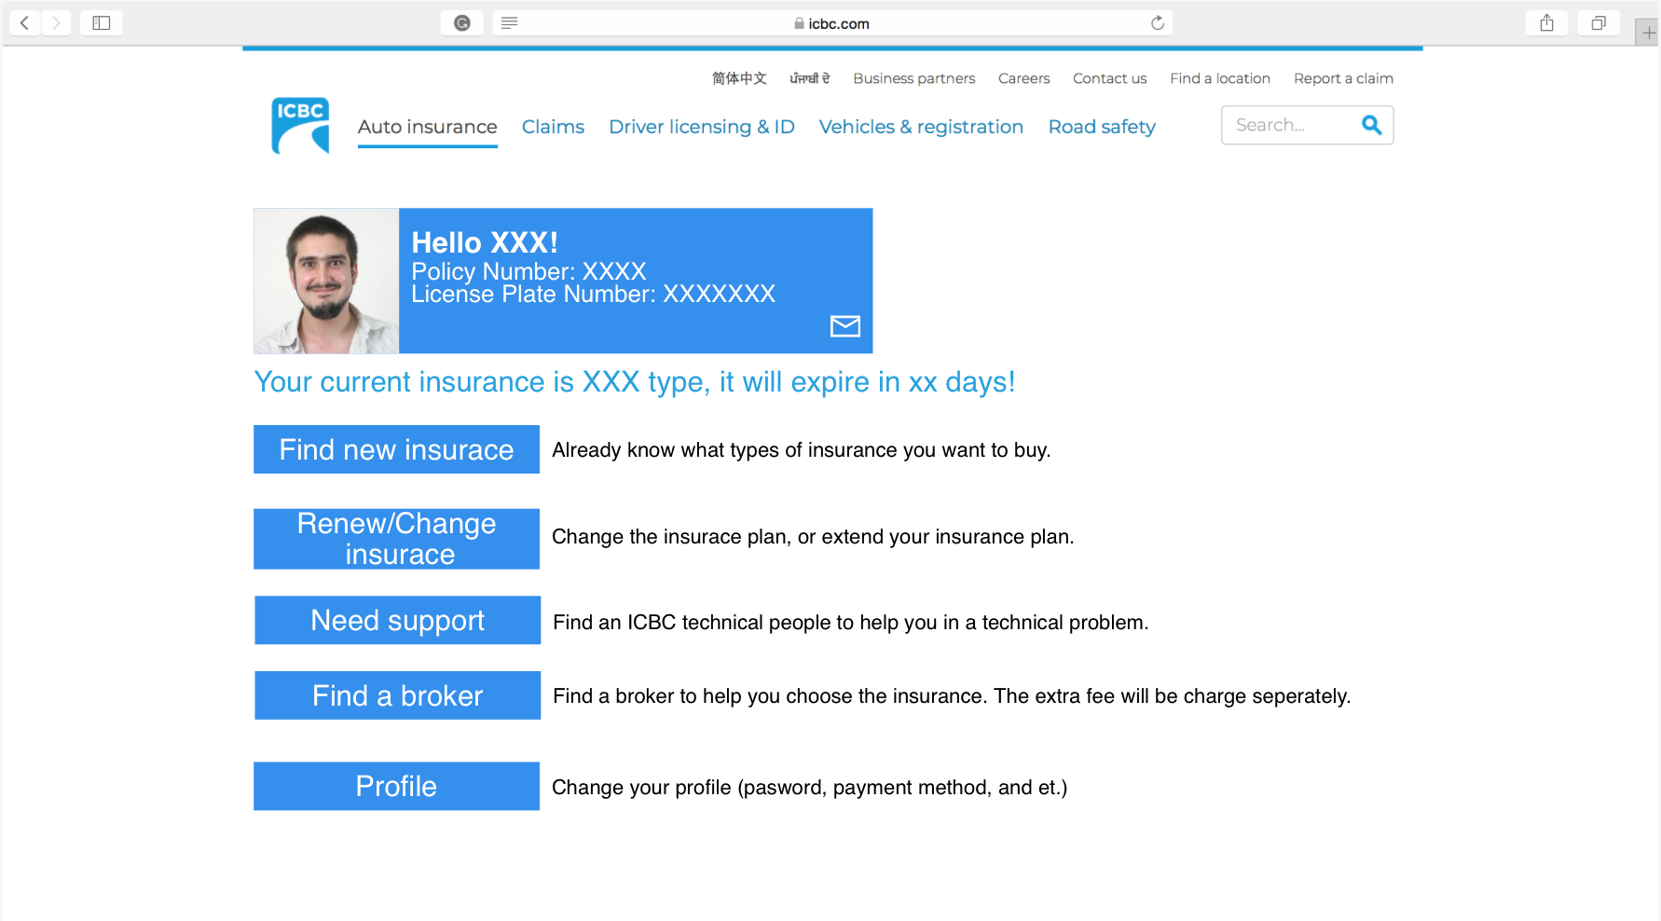
Main User Interface

Slide 10
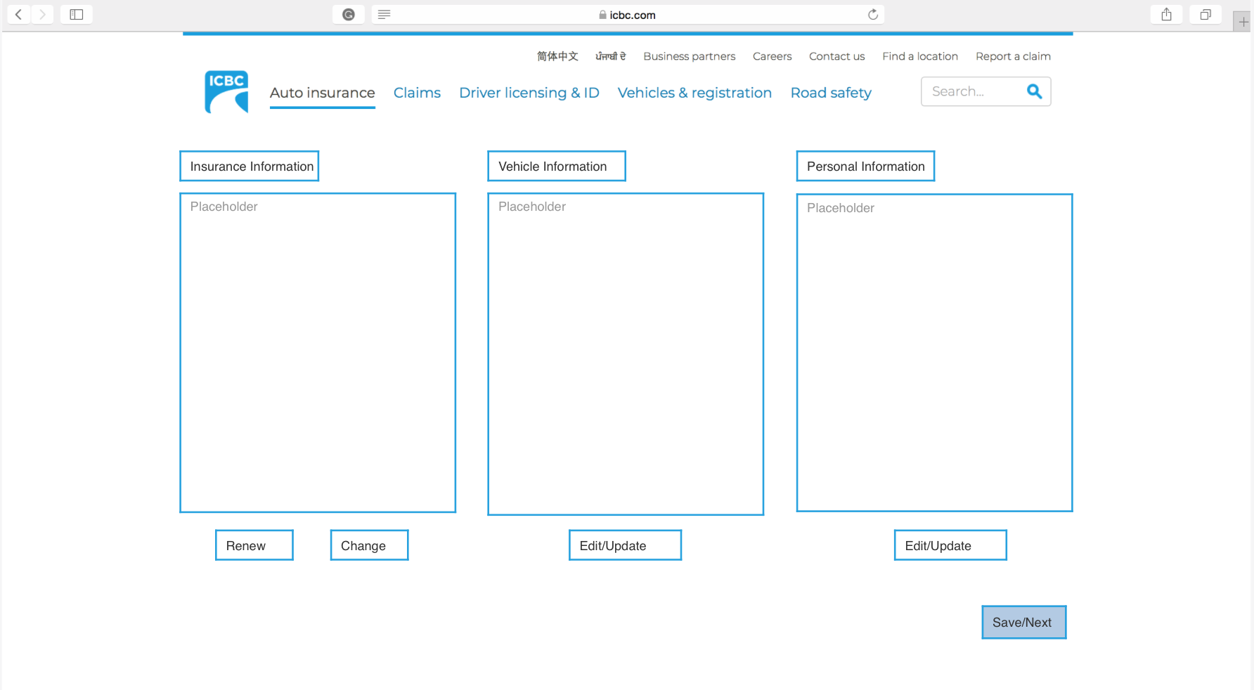
Apply for/Modify Insurance Coverage

Slide 11
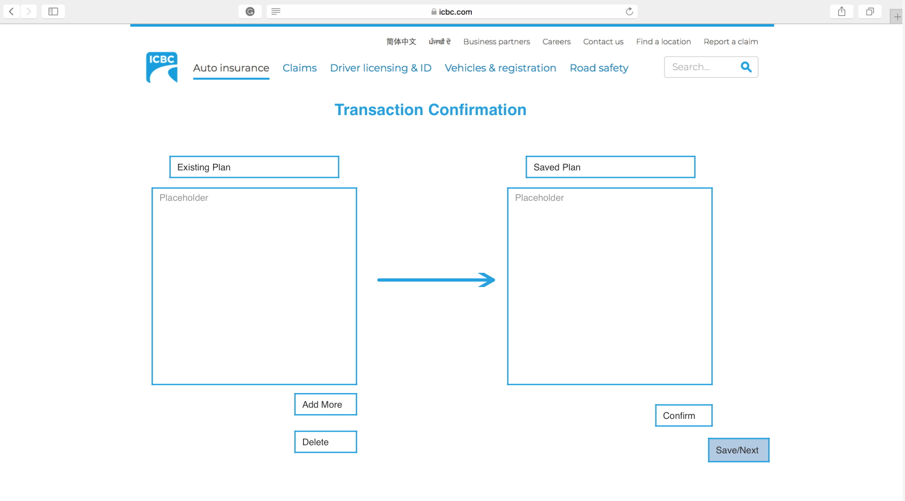
Review Chosen Insurance Plan

Slide 12
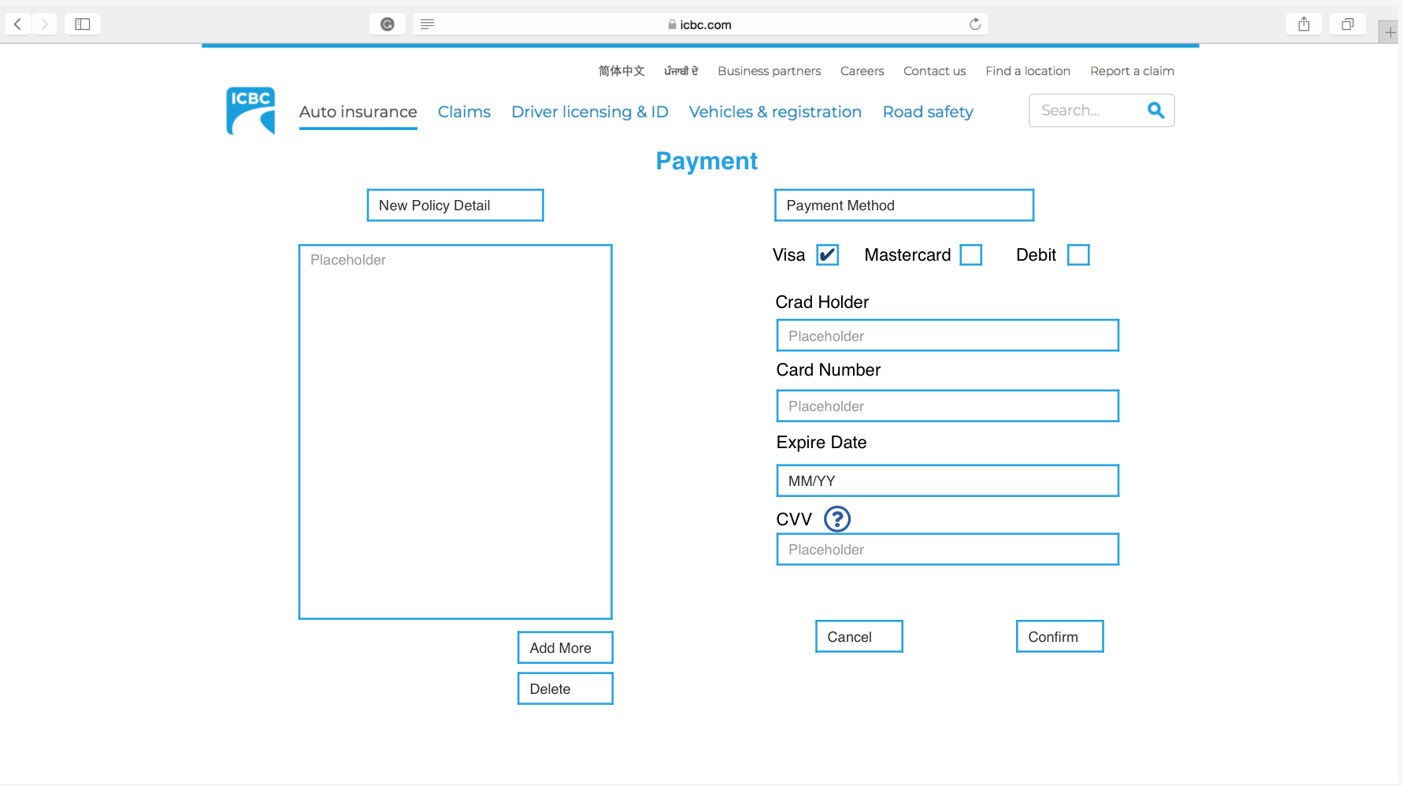
Make a Payment

Slide 13

Problems and Cautions
Delay of transactions: Server overloading, Payment issue
Passing online payment deadline: customer are required to go to ICBC office
System in development: system currently unstable,maintenance, features changing
Data security: personal private information, data encryption
Initial Learning Curve: Basic use Instructions

Slide 14

Cost
Tangible Costs
Equipment
System analysts and developers
Advertisement
Shipping for decals

Slide 15

Benefit
Tangible Benefits
Saving employees’ workload
Reducing salaries expense
Saving time for clients to buy/renew insurance
Intangible Benefits
Increasing customer satisfaction
Customers more informed about their policies
Maintaining a good business image

Slide 16
Cost-Benefit Analysis
Short run: Costs > Benefits
Large investment on buying equipment and hiring system analysts and developer team to build the system
Long run: Benefits > Costs
Reduce the employees in every ICBC office
Smaller team to maintain the system
Good business image

Slide 17

Recommendations
Read through the instruction manual
Communicate with us any concerns or feedback so the development team can implement those ideas
Accessibility: provide disabled, multi-language assistance

Slide 18
Conclusion
Things learned:
System requirements
Use case diagram
Data flow diagram
Information gathering methods
Things to improved in the future
Time management
Customer feedback
Conduct more use case testing on the system
System usability and effectiveness
Notes:
Describe the logical model of the system
the processes or transformation that the data undergo

